Slide 1
Biofire Project
Martin Holdrege
Xavier Kingston
Suyash Mhetre
Sean Zhang
Notes:
suyesh

Slide 2
Introduction
We are attempting to establish a normalization process to provide an estimate of respiratory disease rates
We intend to solve this by establishing a normalization curve for the existing BioFire data which is needed because BioFire is growing rapidly.
Next, we construct the curve for HCUP data for the state of Washington. We will then compare the two curves and adjust the methodology as needed.
Notes:
suyesh

Slide 3
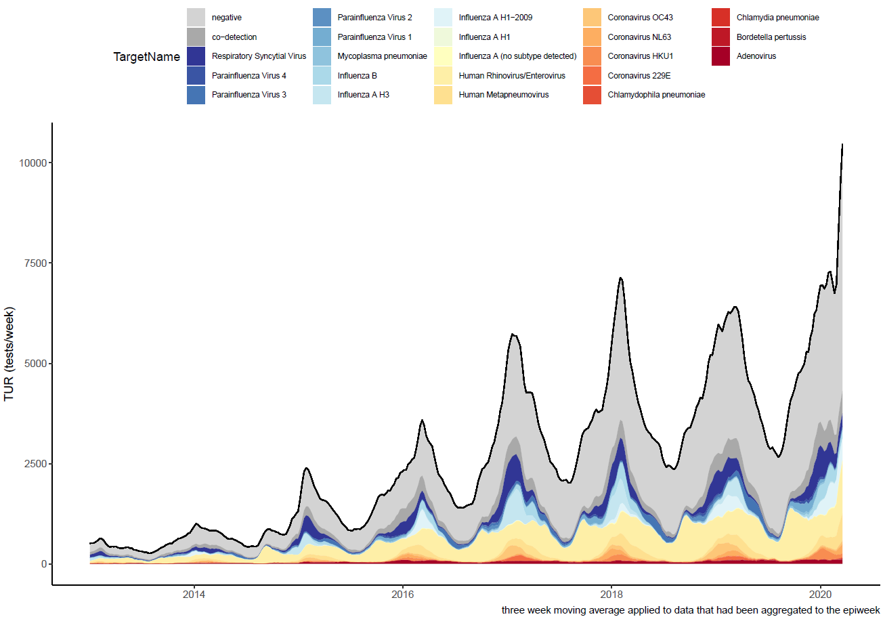
TUR
Notes:
suyash: Test utilization rate

Slide 4

Data - Biofire
Patient testing data from different devices
Focus is on administered respiratory panel tests
Validation tests are excluded
BioFire testing/data is growing, necessitating normalization of raw counts.
Notes:
suyash slides 1-5

Slide 5

Data - HCUP
Data is for the state of Washington
2011-2015
State Inpatient Databases (SID)
Many different attributes; we are looking at diagnosis codes
(9th version: 48,
10th version: J09 - J18).
Counting number of admissions with respiratory disease codes.
Notes:
suyash

Slide 6
Methods--Overview
Since BioFire is growing we want to divide the total number of tests (TUR) by a measure of testing capacity at that time.
Account for the fact that instruments are not only being used for respiratory panel (RP) tests, and that the proportion of RP tests is changing over time.
Account for that fact that the three instrument versions may be utilized at different rates.
Notes:
Xavier

Slide 7
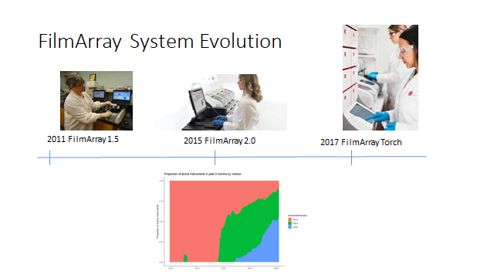
System model distance from the sample loading station and FilmArray computer as well as module value as number increase, may all contribute variablity in rate of tests per system.

Slide 8
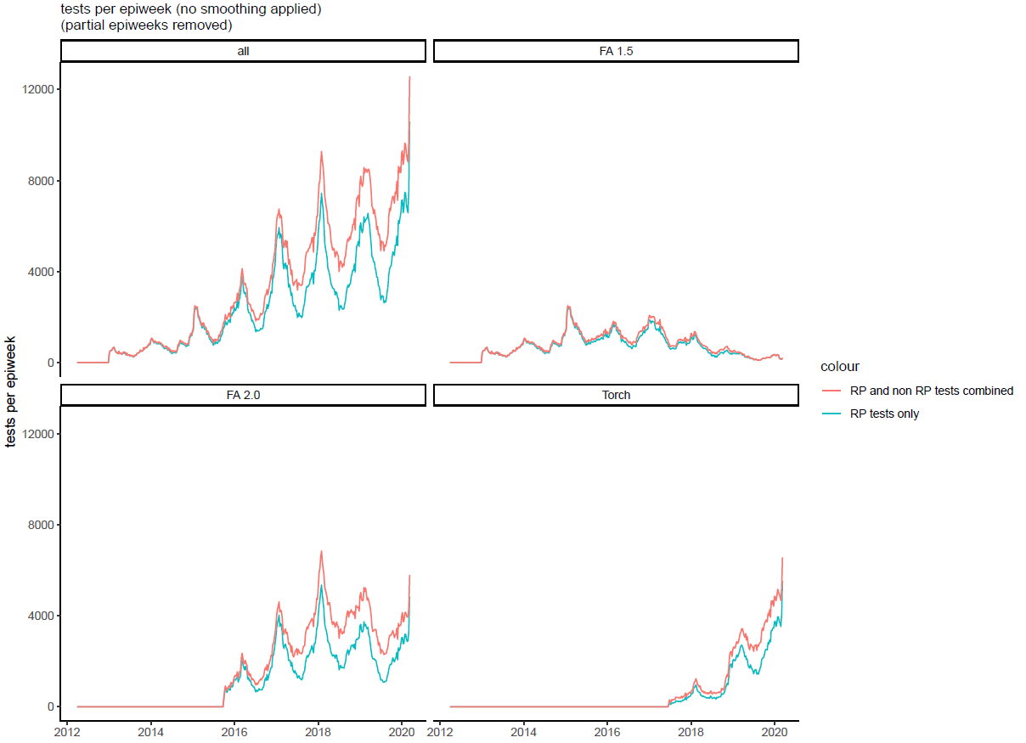
Methods- Respiratory Test counts
TUR is number of RP tests per epidemiological week
all tests
RP tests
Proportion RP is the number RP tests in a 1 year moving window divided by the number of all tests in that window
Notes:
XavierWe are using epiweek which is a definition of week where each week must have 7 days including those at the beginning and end of the year.

Slide 9
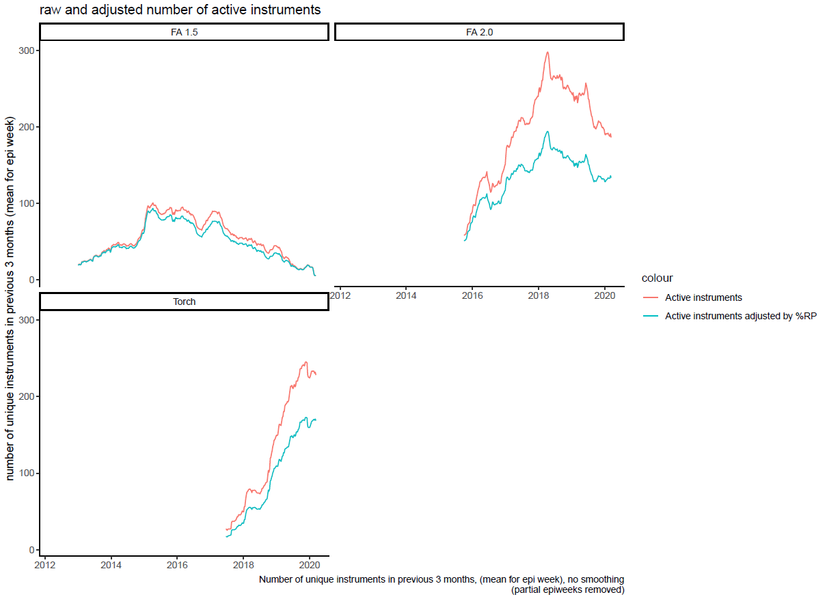
Active Instruments
Active instruments are the number of unique instruments used in the previous three months.
Adjusted active instruments = active instruments * proportion RP tests.
Notes:
Xavier

Slide 10
Y and Y`
Y = RP tests/adjusted active instruments
Y is calculated separately for each instrument version
mean Y differs between instrument versions.
FA1.5 is the original instrument we are using as the gold standard
New variable Y` defined to adjust Torch and FA2.0 to FA1.5
Y`_{FA2.0} = Y_{FA2.0}* mean(Y_{FA1.5})/mean(Y_{FA2.0})
Y`_{Torch} = Y_{Torch}* mean(Y_{FA1.5})/mean(Y_{Torch})
Notes:
Xavier

Slide 11
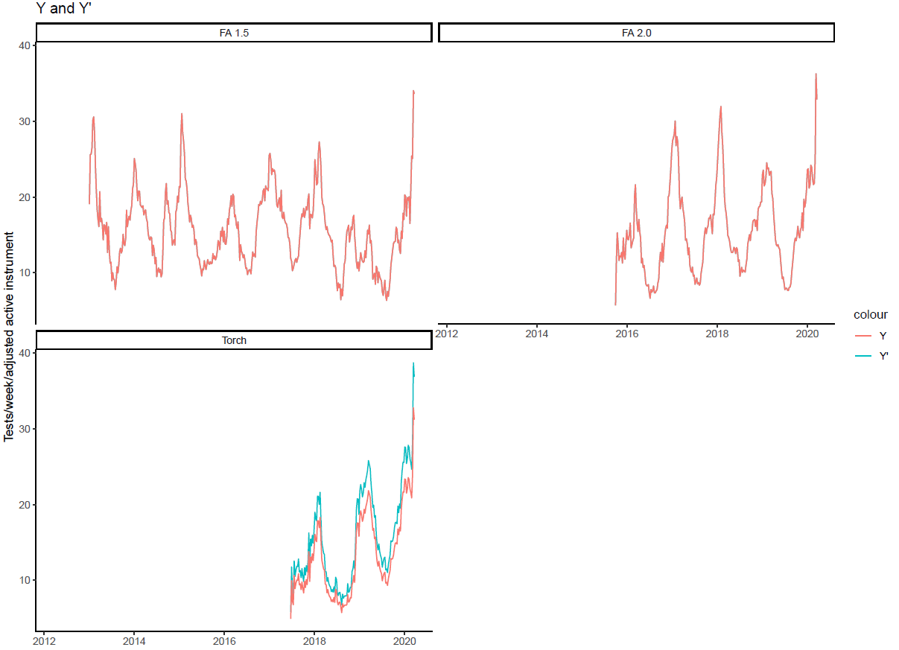
Y = TUR/adjusted active instruments
Y and Y`
Y`_{FA2.0} ~ Y_{FA2.0} because FA2.0 used at ~ same rate as FA1.5 (because of overplotting Y`_{FA2.0} is not visible)
Y`_{Torch} > Y_{Torch} accounting for the fact that Torch used at a lower rate than FA 1.5
Notes:
Xavier

Slide 12
Caclulating TURN (Y``)
weighted average* of Y_{FA1.5}, Y`_{FA2.0} and Y`_{Torch}= Y`` = TURN
*weighted by the number of active instruments of each instrument version
Notes:
Martin

Slide 13
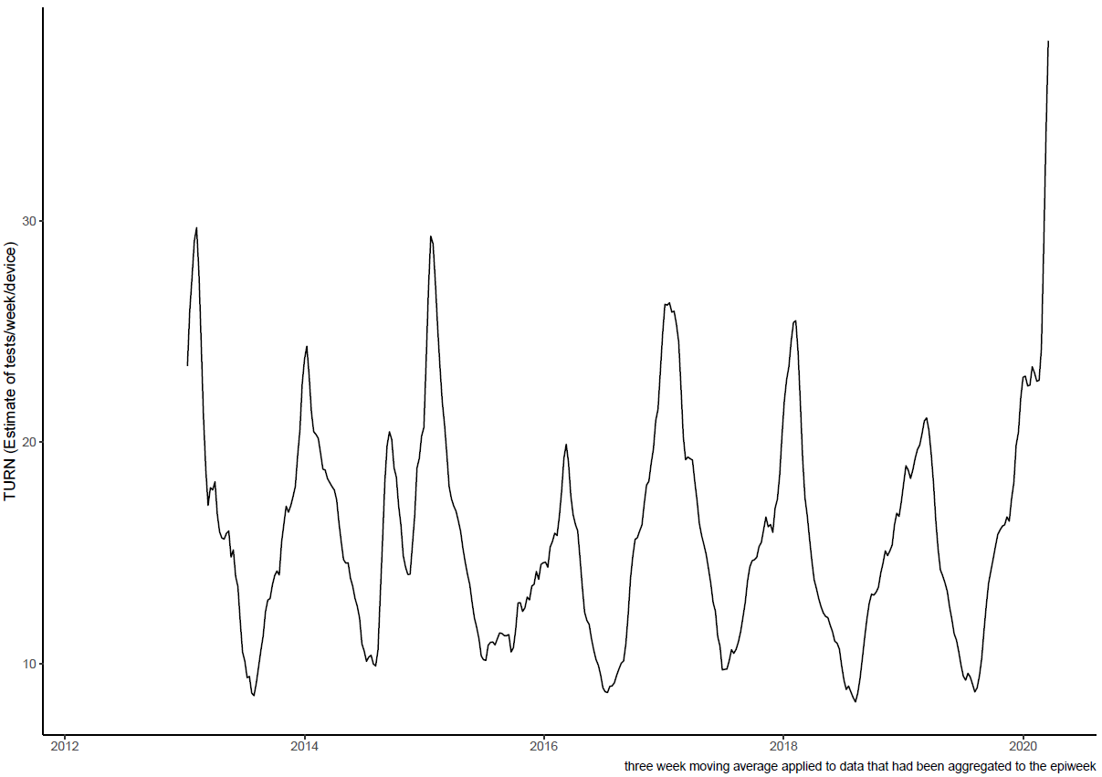
TURN
(three week moving average applied)
Notes:
Martin

Slide 14
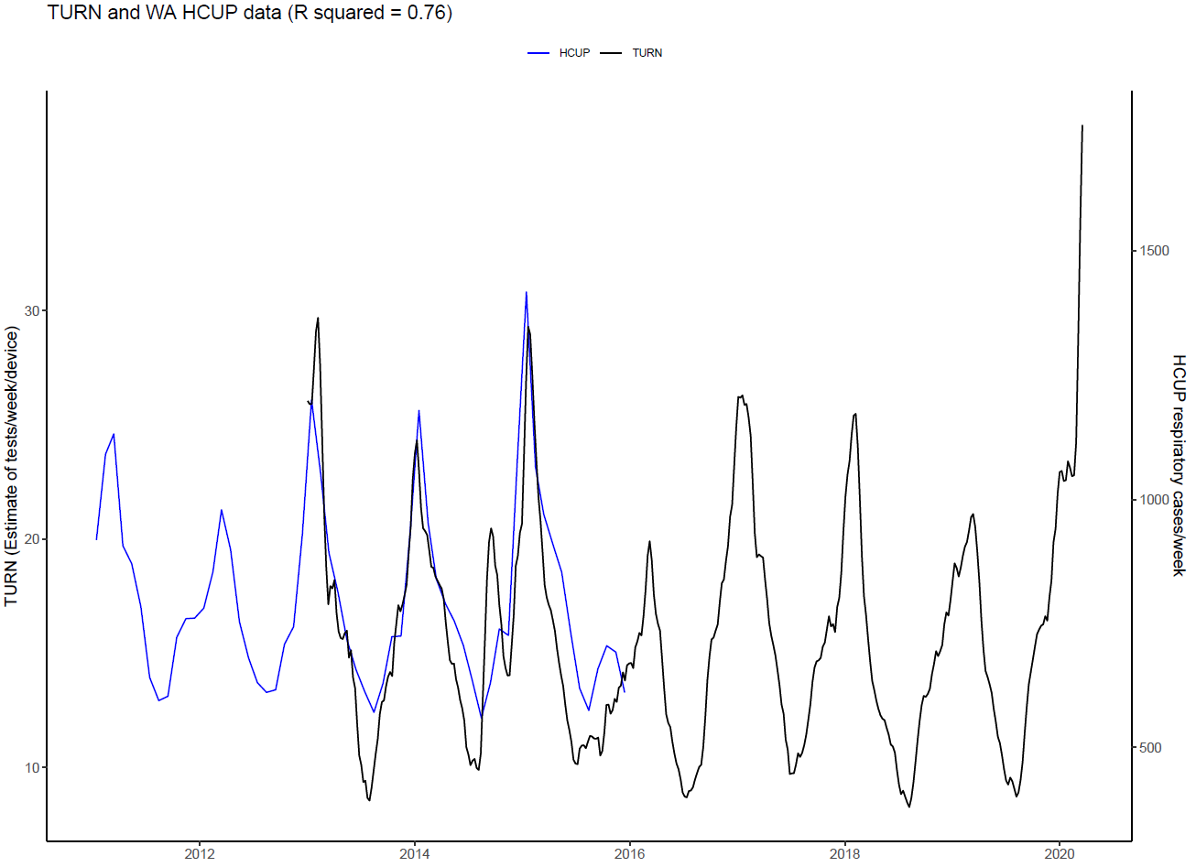
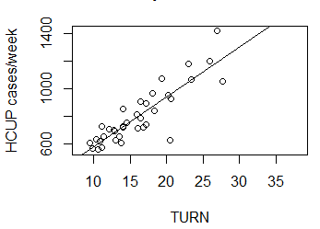
Notes:
Martin

Slide 15
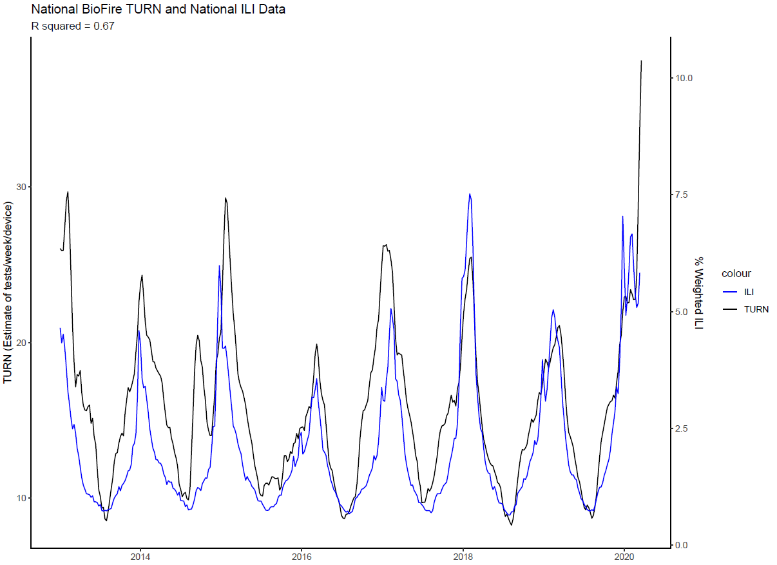

Slide 16
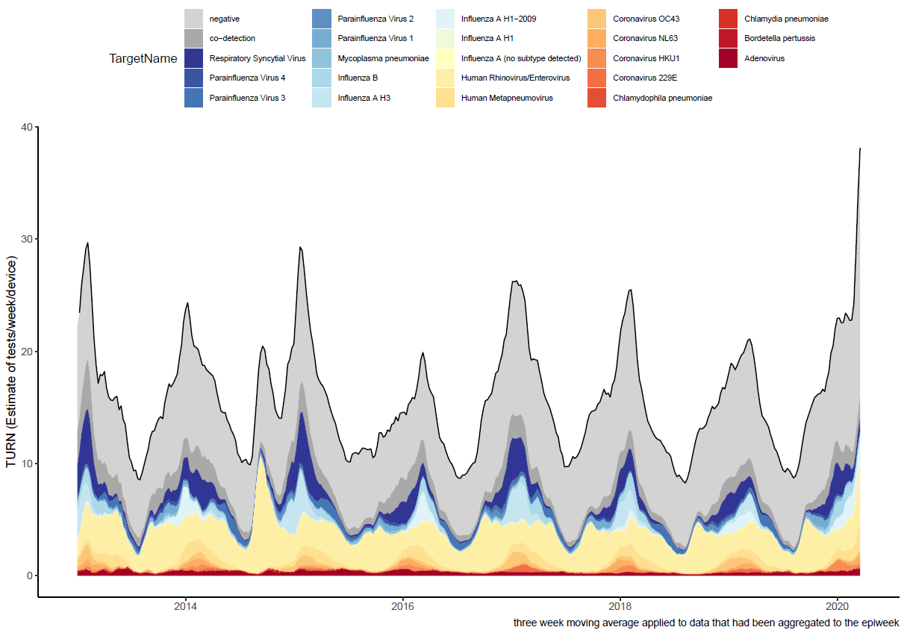
TURN
Most of the recent unprecedented rise in TURN is driven by negative tests
Black line is total TURN
shaded areas show proportion of total TURN contributed by a particular pathogen
Notes:
sean

Slide 17
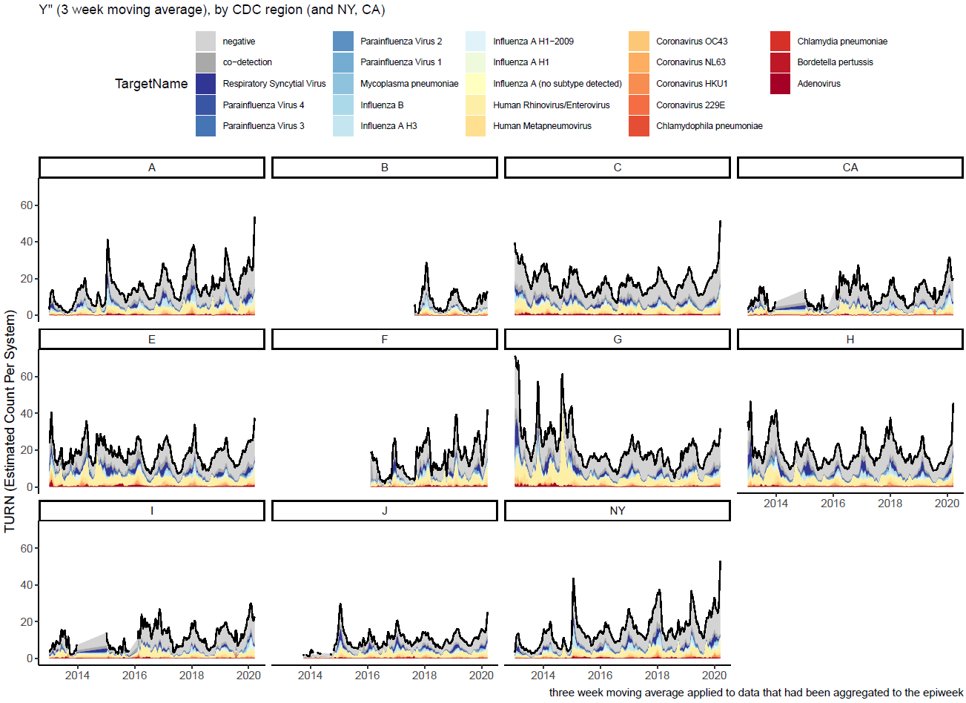

Slide 18
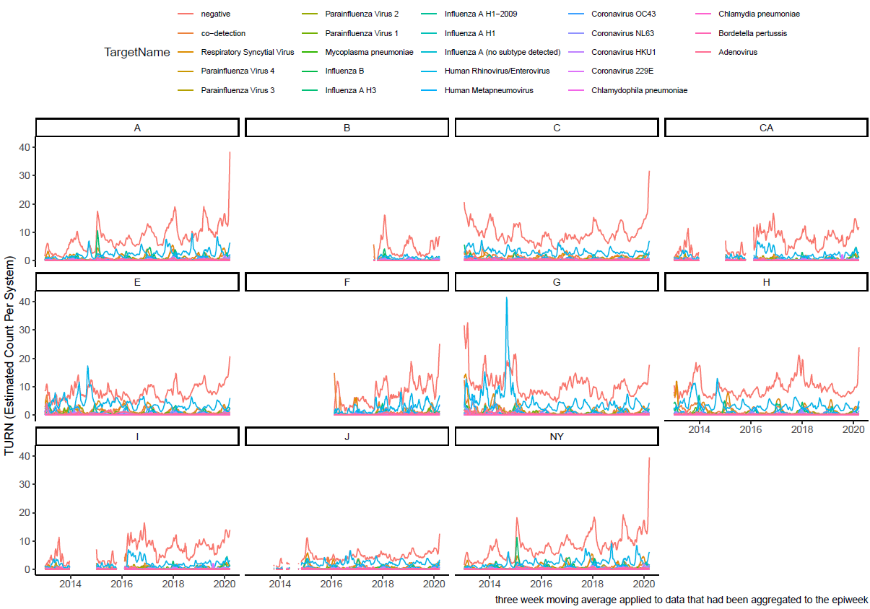
TURN of pathogen detections by CDC Region and NY and CA

Slide 19
Observations/Conclusion
There was a good match between national BioFire TURN and the Washington HCUP data and national ILI
The rate of negative tests may be an important indicator to help detect spikes in COVID-19.
Notes:
sean - pandemic spike, arbitrary washington Inpatient data
Y’ weighted average

Slide 20
What’s Next?
Obtain HCUP data for Michigan SID for recent years (2014-2017) delayed by COVID19
Provide Group 1 TURN to other teams to compare to their TURN’s (practice making our records public)
Present to BioFire Executives
Assist in preparing manuscript
Notes:
sean
provide alex the method

Slide 21
Questions?
Notes:
everyone

